Slide 1
Grain Biosecurity
Lesson 8 | Data collation

Slide 2
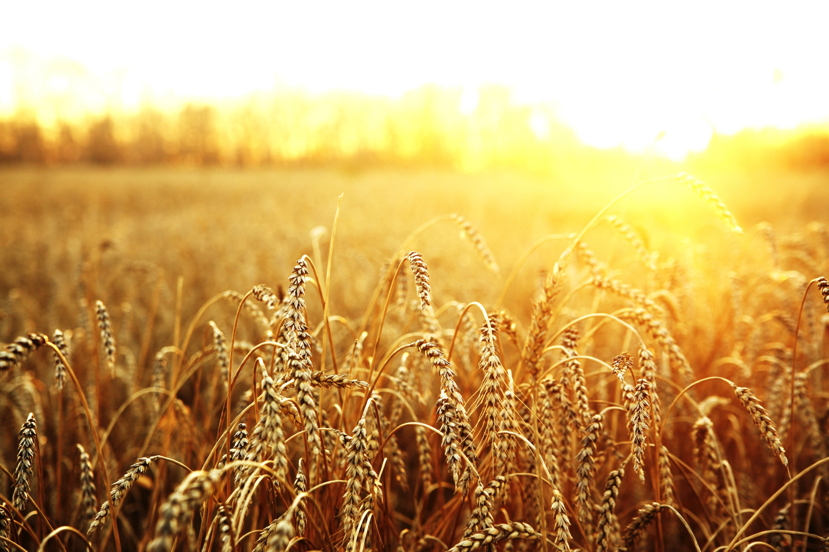
Data collation
What’s bugging the farm?

Slide 3
Data collation worksheet
Sticky Trap Pitfall trap
Your group Class total Your group Class total
Total number of insects trapped
Number of Insect Orders
List Insect Orders found
Most common Insect Order
Any Biosecurity threats?

Slide 4
Analysing the results
Draw a bar graph of your group’s sticky/pitfall trap data and compare with the whole class.

Slide 5
Sticky Trap Data

Slide 6
Pitfall Trap Data

